Slide 1
Node js
Day 1
shimaa ismail

Slide 2
content
introduction
clinet side web architecture
app server vs web server
what is node.js
Node.js vs Browser
Event Loop
Blocking vs Non-blocking
globle ,REPL, process
modules
file system module

Slide 3
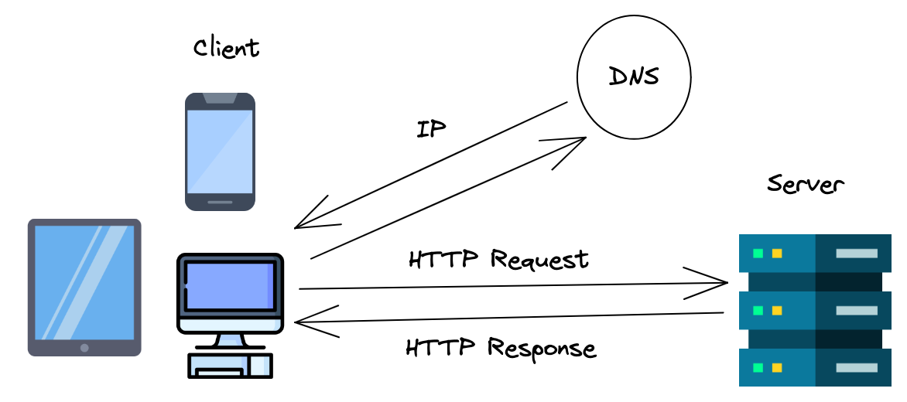
web

Slide 4
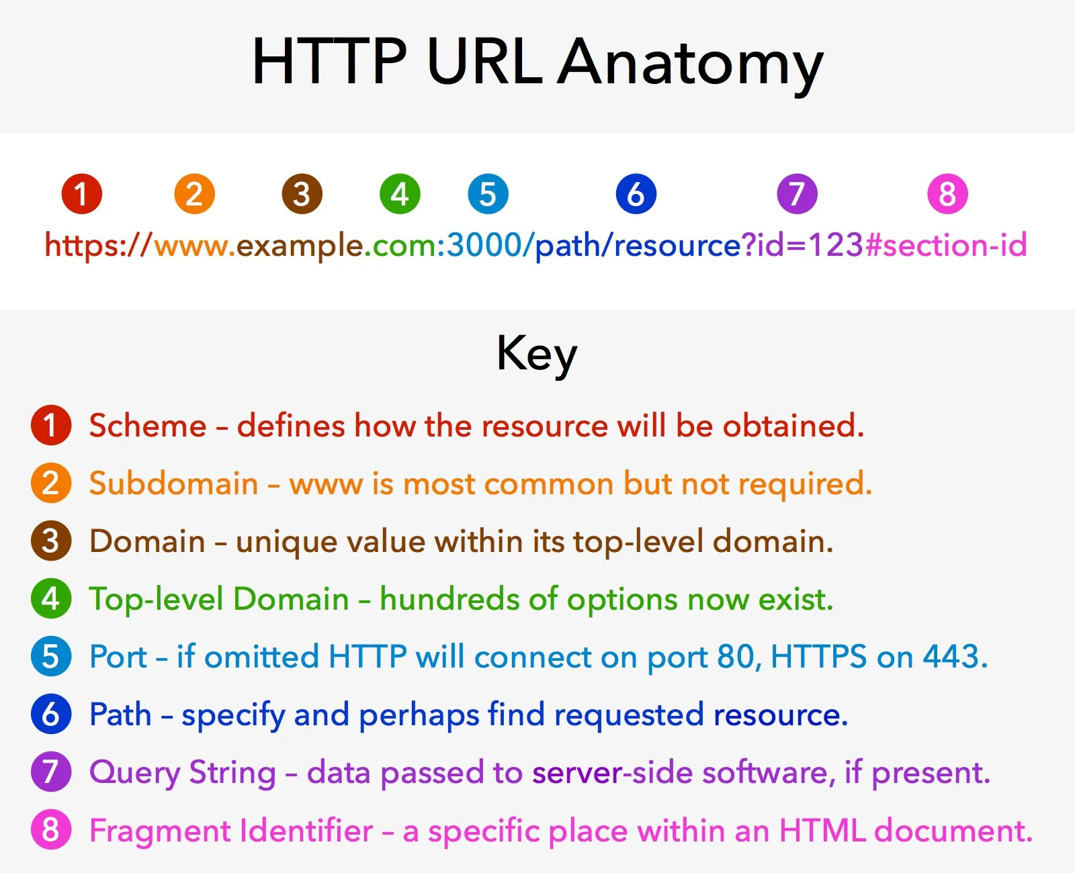

Slide 5
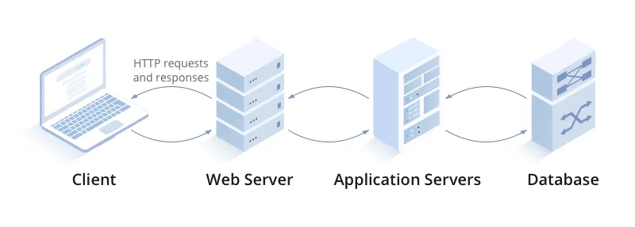
app server vs web server

Slide 6
Node js
is a runtime environment for executing JavaScript outside the browser, built on the V8 JavaScript engine.
Node created by Ryan Dahl in 2009.
is a free, open-source, cross-platform JavaScript runtime environment that lets developers create servers, web apps, command line tools and scripts.
Node JS is not a programming language, a framework, or a library.
Event-Driven, Non-Blocking I/O: Handles multiple requests efficiently without waiting for previous tasks to finish.
Single-Threaded Model: Uses an event loop to manage many connections
compaines use node js :: PayPal , Netflix , LinkedIn , Uber , NASA.
Real-Time Applications,Web APIs,Streaming Applications

Slide 7
Blocking vs non Blocking
Blocking ( synchronous)
Code is executed line-by-line. If one line takes 5 seconds, the next line waits 5 seconds
non Blocking (asynchronous)
Code initiates a task and moves to the next line immediately. The task continues in the background.
Uses an event-driven architecture to handle multiple requests without waiting, improving performance.

Slide 8
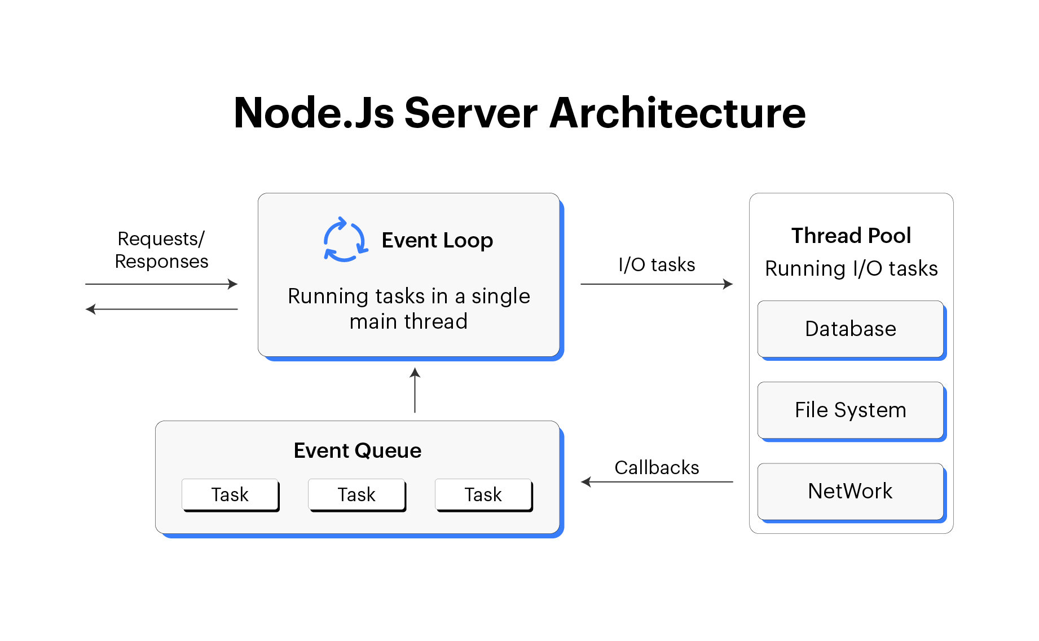

Slide 9
why use Node.js
High Performance: Built on Chrome’s V8 engine for fast execution
Event-Driven Model: Handles multiple requests using a non-blocking event loop
Unified Language: Uses JavaScript for both frontend and backend
Rich Ecosystem: Extensive npm libraries and tools
Real-Time Capabilities: Suitable for chat apps and live updates
Cross-Platform: Works on Windows, macOS, and Linux

Slide 10
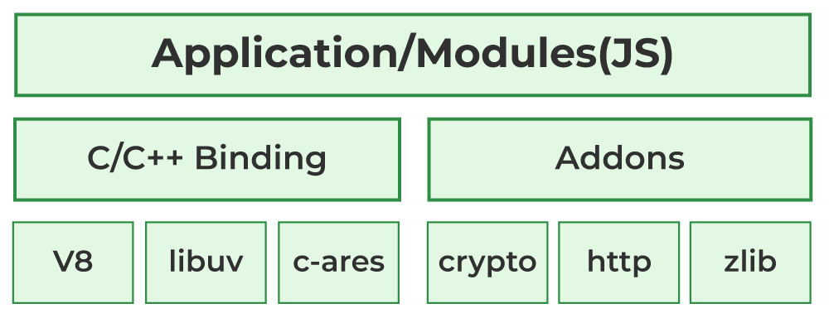
Node JS Environment

Slide 11
set up node js go to : https://nodejs.org/en/download
Getting Started

Slide 12

npm
npm ==> Node Package Manager
installed automatically when you install Node.js.
npm is the world's largest software registry.
the Command Line that help to install and manage packages

Slide 13
Modules
modules are reusable blocks of code that help organize applications into separate files. They improve code maintainability, reusability, and structure.
Encapsulate related functionality in separate files.
Can be imported using require() or import.
Types of node.js Modules :
Core Modules (built-in modules)
Local Modules (custom modules)
Third-Party Modules (created by external developers npm packages )

Slide 14
Core Module
These are built-in modules provided by Node.js.
They come with the Node.js installation and don’t require any additional setup.
For example::
fs (file system),
http is used to create HTTP servers
os , path

Slide 15
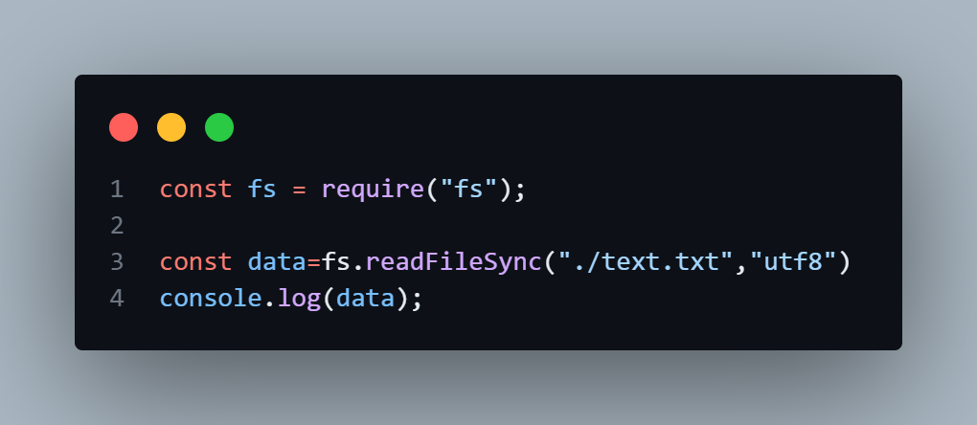
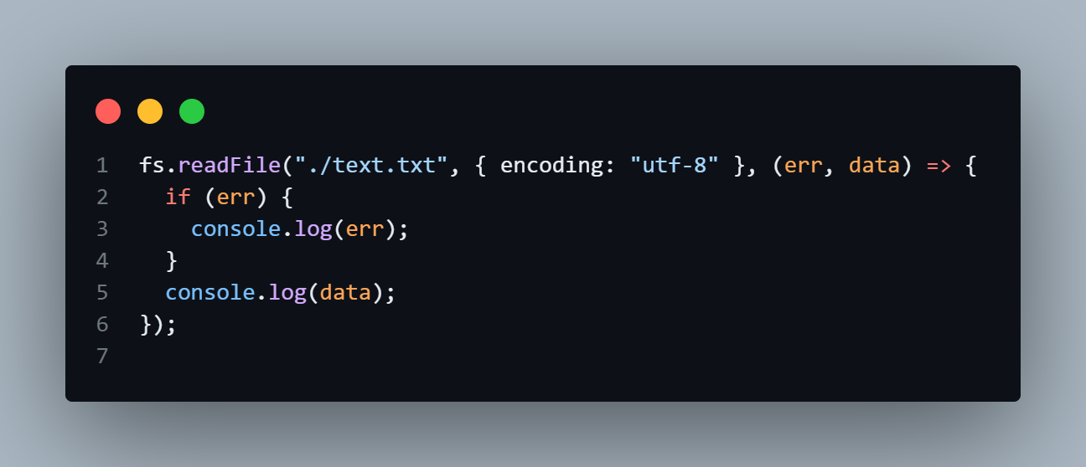
fs (File System)
The fs (File System) module in Node.js is a built-in module used to interact with the file system. It supports both synchronous and asynchronous operations for handling files and directories efficiently.

Slide 16
Modular Programming
ES6 Modules (ECMAScript Modules - ESM)
CommonJS Modules (CJS)

Slide 17
Node REPL
NodeJS REPL (Read-Eval-Print Loop) is an interactive shell that allows you to execute JavaScript code line-by-line and see immediate results. This tool is extremely useful for quick testing, debugging
READ: You type some JavaScript code into the terminal, and REPL reads what you typed.
EVAL: REPL runs (evaluates) your code.
PRINT: REPL shows you the result of your code.
LOOP: REPL goes back to step 1, waiting for you to type more code.This loop continues until you quit REPL.

Slide 18
process.argv

Slide 19
demo

Slide 20
THANK YOU

